Slide 1
SOFFA
FUNDING

Slide 2
ELIGIBILITY
  BE REGISTERED WITH STUDENT ACTIVITIES FOR THREE CONSECUTIVE ACADEMIC YEARS, INCLUDING 2026-2027
  BE IN GOOD CONDUCT STANDING
  NOT HAVE RECEIVED ANY FUNDING IN THE FISCAL YEAR 2027 SSF BUDGET
  COMPLETE SOFFA TRAINING PRIOR TO THE FUNDING APPLICATION DEADLINE
REQUESTED PROGRAMS SHALL
  HAVE BEEN OFFERED AT LEAST TWICE IN THE LAST 2 ACADEMIC YEARS
  BE HELD BETWEEN JANUARY 1 AND MAY 31 FOR SPRING, JUNE 1 AND JULY 31 FOR SUMMER, OR AUGUST 1 AND DECEMBER 31 FOR FALL.
  BE PRIMARILY PLANNED, COORDINATED, AND MANAGED BY THE REQUESTING STUDENT ORG.

Slide 3
PROGRAMS
  ON CAMPUS EVENTS (WITH VERIFIED EVENT APPLICATION) FREE AND OPEN TO THE STUDENT BODY
  SERVICES OR PROJECTS (COMMUNITY SERVICE) THAT ARE FREE AND OPEN TO THE STUDENT BODY

Slide 4
PROCESS
  WATCH SOFFA TRAINING VIDEO AND TAKE QUIZ
  SUBMIT FUNDING APPLICATION, MUST BE APPROVED BY PRESIDENT AND ADVISOR, BY THE DEADLINE
    A FUNDING REQUEST MAY INCLUDE MULTIPLE PROGRAMS, A SEPARATE BUDGET MUST BE SUBMITTED FOR EACH PROGRAM, ALONG WITH 2 PRIOR EVENT APP LINKS
  SOFFAC REVIEWS THE APPLICATION AND NOTIFIES ORGS IF REQUEST IS ELIGIBLE
  STUDENT ORG PRESENTS BUDGET REQUEST TO SOFFAC (ONLINE OR IN PERSON)
  COMMITTEE WILL DELIBERATE AND NOTIFY THE ORGANIZATION OF DECISION
  STUDENT ORG SCHEDULES AN EVENT CONSULTATION FOR FUNDED EVENT
  STUDENT ORG WORKS WITH STUDENT ACTIVITIES TO MAKE PURCHASES FOR ALLOCATED PROGRAM
  COMPLETE POST-PROGRAM EVALUATION

Slide 5
REQUIREMENTS AFTER AWARDED
  MAINTAIN REGISTRATION STATUS AND GOOD CONDUCT STANDING
  ATTEND EVENT CONSULTATION AND BUDGET MEETINGS WITH STUDENT ACTIVITIES, FOR EACH ALLOCATED PROGRAM
  MEET PROGRAM STIPULATIONS SET BY STUDENT ACTIVITIES OR THE EVENT SAFETY COMMITTEE
  FOR EVENTS
    SUBMIT AN EVENT APPLICATION AT LEAST 15 BUSINESS DAYS AHEAD OF INTENDED 1ST CHOICE HOST DATE
    CARD SWIPE AT EVENT
    COMPLETE POST-PROGRAM EVALUATION WITHIN 14 BUSINESS DAYS OF THE EVENT
  FOR SERVICE PROJECTS
    COMPLETE A POST-SERVICE/PROJECT EVALUATION WITHIN 14 BUSINESS DAYS OF THE SERVICE/PROJECT COMPLETION

Slide 6
GUIDELINES
  IF AN ORG RECEIVES SOFFA, THE ORG MAY ONLY REQUEST SUPPLEMENTAL FUNDING IF BUDGETARY CHANGE OCCURS OUTSIDE ORG CONTROL, FUNDING IS NOT GUARANTEED, AND IS SUBJECT TO THE APPLICATION AND APPROVAL PROCESS OF AWARDING BODY
  IF A PROGRAM IS A CO-SPONSORSHIP BETWEEN ORGANIZATIONS, THE ORGANIZATIONS MAY ONLY APPLY FOR FUNDING FROM ONE SOURCE
  ALL PURCHASES ARE PROCESSED THROUGH STUDENT ACTIVITIES; STUDENT ORGS CANNOT MAKE PURCHASES AND BE REIMBURSED
  IF AN ORG DOES NOT USE ALL THEIR ALLOCATED FUNDS, FUNDS WILL NOT BE REALLOCATED FOR USE ON ANOTHER ACTIVITY OR MAINTAINED BY THE STUDENT ORGANIZATION
  ORGS THAT FAIL TO SUBMIT PURCHASING REQUESTS OR DOCUMENTS BY DEADLINES SET BY STUDENT ACTIVITIES MAY FORFEIT FUNDS ALLOCATED TO THAT ACTIVITY
  STUDENT ACTIVITIES WILL NOT FUND ANY ACTIVITY THAT VIOLATES UNIVERSITY POLICY, STUDENT CODE OF CONDUCT, OR LOCAL, STATE, OR FEDERAL LAW

Slide 7
GUIDELINES
  IF AN ORGANIZATION FAILS TO MAINTAIN ELIGIBILITY OR MEET REQUIREMENTS AFTER AWARDING, APPROVED BY A ⅔ VOTE OF SOFFAC, THE ORG FORFEITS THE FUNDS ALLOCATED TO THEM FOR THAT SEMESTER AND/OR BE REQUIRED TO REIMBURSE STUDENT ACTIVITIES FOR ANY FUNDS ALREADY EXPENDED ON THE ORG’S BEHALF.
  IF AN ACTIVITY IS CANCELLED, THE ORG MAY, IF APPROVED BY ⅔ VOTE OF SOFFAC, BE REQUIRED TO REIMBURSE STUDENT ACTIVITIES FOR ANY FUNDS EXPENDED ON THE ORG’S BEHALF AND BE INELIGIBLE FOR FUTURE FUNDING UNTIL FUNDS ARE REIMBURSED.
  A STUDENT ORG DEMONSTRATING ACTIVITY NOT ALIGNING WITH THE MISSION OF THE UNIVERSITY MAY, IF APPROVED BY ⅔ OF SOFFAC, FORFEIT REMAINING FUNDS ALLOCATED TO THE ORG FOR THAT SEMESTER AND/OR MAY BE REQUIRED TO REIMBURSE STUDENT ACTIVITIES FOR FUNDS ALREADY EXPENDED; ADDITIONALLY, IF THE ORG’S ACTIONS ARE EGREGIOUS, THE ORG, IF APPROVED BY ⅔ VOTE OF SOFFAC, BE DEEMED INELIGIBLE TO APPLY FOR SOFFA FUNDS THE FOLLOWING SEMESTER.

Slide 8



APPLICATION
Process

Slide 9


Application Info
Some of the information needed:
  Contact info for organization President
  SOFFA contact person for the organization
  Type of program requesting (event/service project)
  Justification (why funding needed, how the organization/campus community benefits from the program)
  Budget (use the template in the application)
  Projected attendance, prior attendance
  Event application links from last two times
on-campus event was hosted
Application located on the SOFFA website

Slide 10
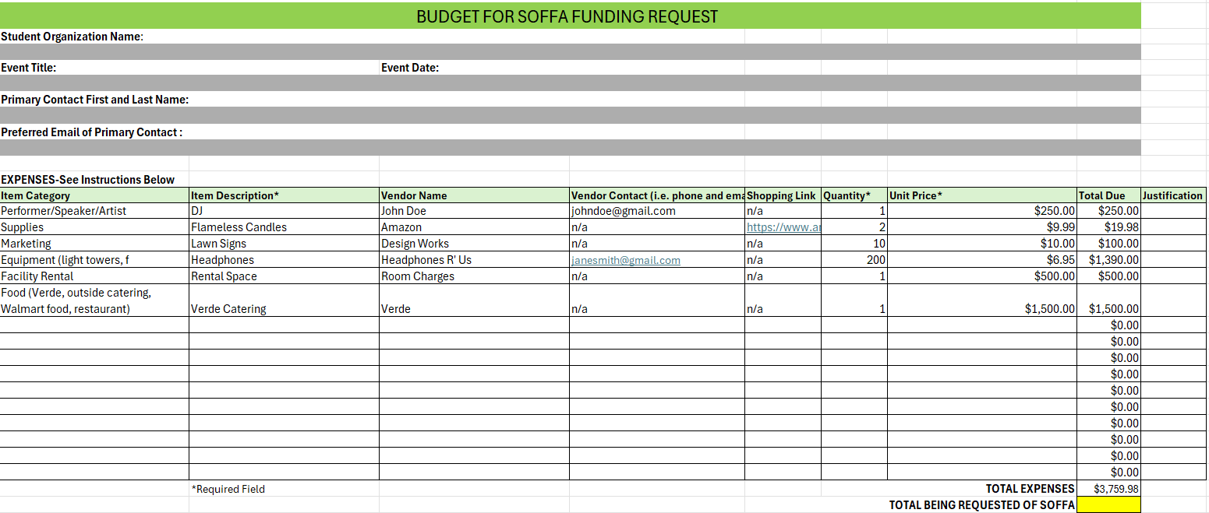
Budget Template - Expenses
You must use this Excel template and upload it to your application, DO NOT save this as a pdf. Make sure all parts of the template are filled out before submitting, including the projected event date.

Slide 11
Budget Template - Expenses Breakdown
  Item Category is the type of item (supply, food, facility, speaker/performer, technology, equipment, decoration, etc.)
  Item description is the specific item being purchased
  Vendor name is the company you are purchasing from
  Vendor contact is an email or phone number we can use to contact the vendor if we need assistance with the purchase (please also give name of the person as well)
  Shopping link for any items to purchase from a website
  Quantity is how many are being bought, if something is a set or grouped more than one (i.e. set of 4 and you want 2, that means you are getting 8 of something)
  Unit price is how much 1 of that item costs, it is not the total
  Total due is how much the total cost would be for the total quantity of that item
  Please make sure to put a justification of WHY you need that item, and how it will benefit the program

Slide 12
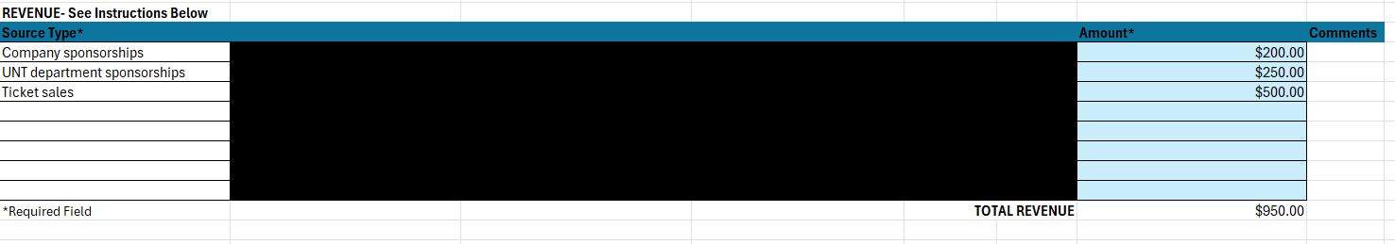
Budget Template - Revenue
Make sure to include any revenue you are likely to generate from the event (i.e. ticket sales, admission fees,
sponsorships, donations, etc.). This is a projection, but you can use prior numbers from the last time you held the event.

Slide 13
Presentation
  The presentation is the opportunity for you to explain your request, how the program/service benefits the organization, campus community, why you need the funds, what you are purchasing, etc. A powerpoint, slideshow, or visual aid for your presentation is highly recommended.
SOFFAC members will ask you questions about your request. Please make sure whoever is presenting on behalf of your organization is knowledgeable of the program or service.

Slide 14
Award Notification
After your presentation, you will be notified of your award, whether you were approved or denied.
If you were approved, your letter will state how much you were approved for and the allocation of each line item.
If you were denied, you will have a notification in your UNT email stating why you were denied or not allocated funds. Please know that funds are limited; so as much as we would like to fund all requests, unfortunately we may have to make cuts to requests as well.

Slide 15
Event Consultation
You will meet with Student Activities to discuss your program/service, deadlines, purchasing guidelines, marketing, and risk management strategies. This is an opportunity for you to ask any questions you may have to help you better execute your program/service.
Additionally, we will provide you with a few tools and resources that will help guide you such as a list of deadlines (when to submit event app, purchasing dates, etc.) and event checklist.

Slide 16
Leading Up To and Day of Program/Service
  Make sure you continue to follow all deadlines.
  Meet with Budget Officer in Student Activities to make purchases for program/service
  If anything changes in your budget, please let us know immediately, if something is unforeseen we may be able to adjust
  Make sure you are following up on your event app, responding to any comments or questions
  Execute items on event check list

Slide 17
Post-Program Evaluation
  Within 14 Business Days, complete SOFFA Post-Program Evaluation
  Answer questions about attendance, what you learned, improvements for next year, did the program/service achieve its goals, what aspects were successful, etc.
  This tool will be a resource used in the event consultation when the program/service is requested the following year for SOFFA funds.

Slide 18
Key Takeaways
1
  Programs eligible (On-Campus Event/Service, twice in the last 3 years)
  2
  An org may only request supplemental funding if budgetary change outside org control
  3
  In the application, make sure to provide at least 2 prior event app links for the requested program
  4
  Make sure your budget has everything needed for your program
  5
  Set up your Event Consultation with Student Activities
  6
  Orgs that fail to meet purchasing deadlines may forfeit funds allocated to that activity
  7
  Ensure you cardswipe for the event and complete the Post-Program Evaluation

Slide 19
QUESTIONS?
PLEASE CONTACT STUDENT ACTIVITIES, STUDENT.ACTIVITIES@UNT.EDU

